Slide 1
Introduction to Arduino
CryoSkills Pilot Course
14th February 2024

Slide 2
Contents
Hardware
Signals
Data Communication
Arduino IDE
Programming
Example
Tasks

Slide 3
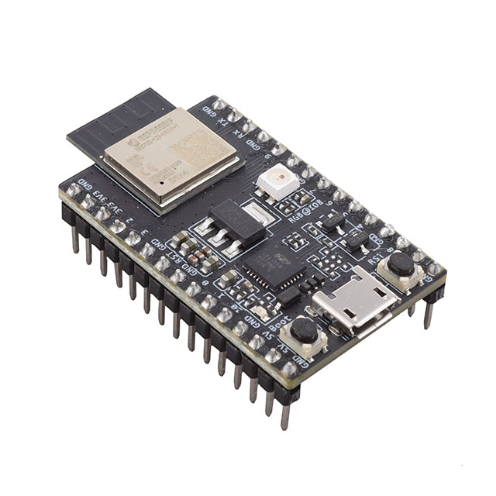

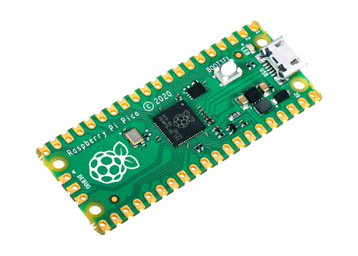
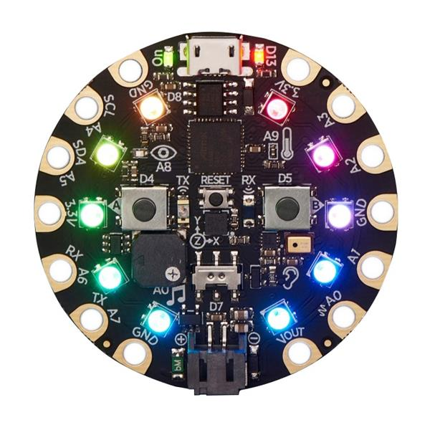
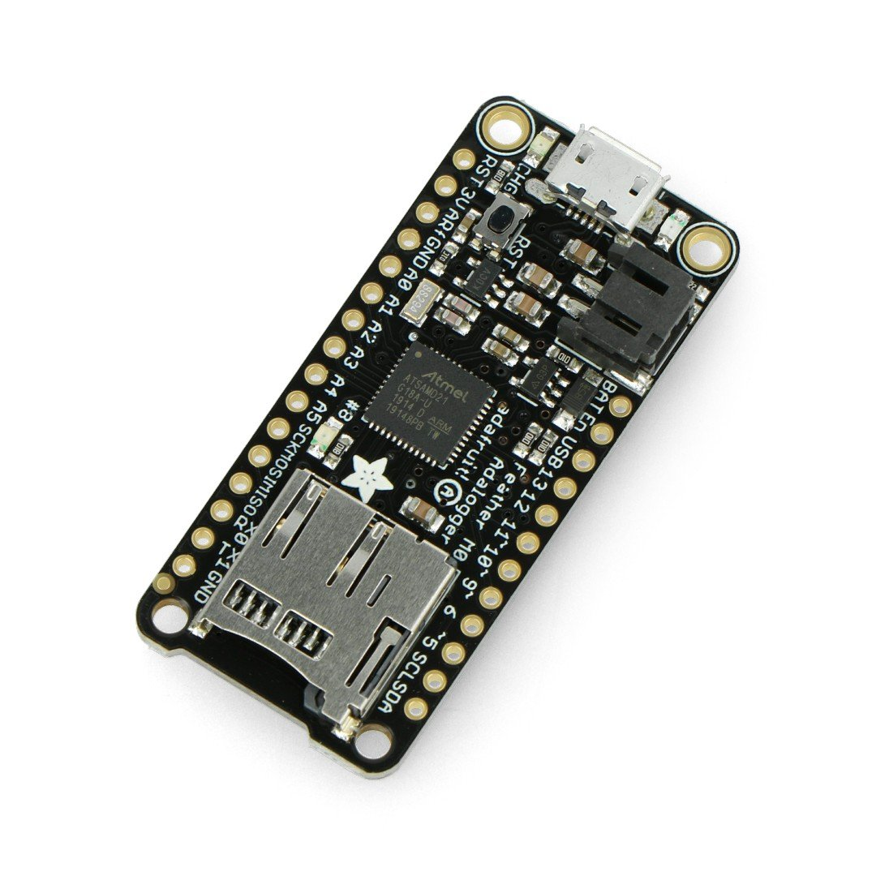
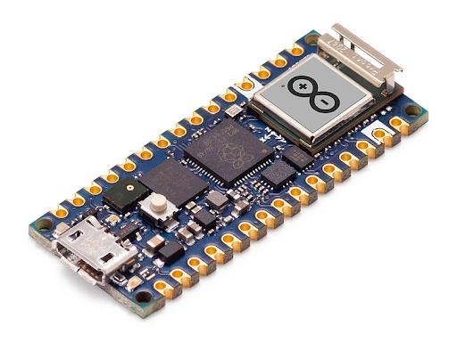
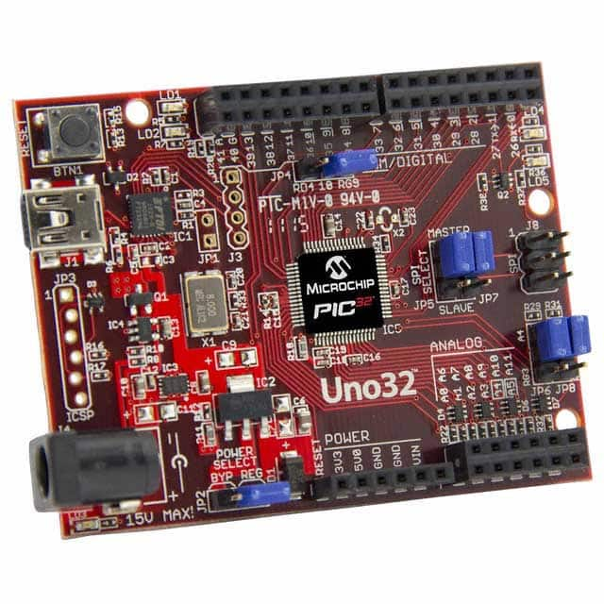
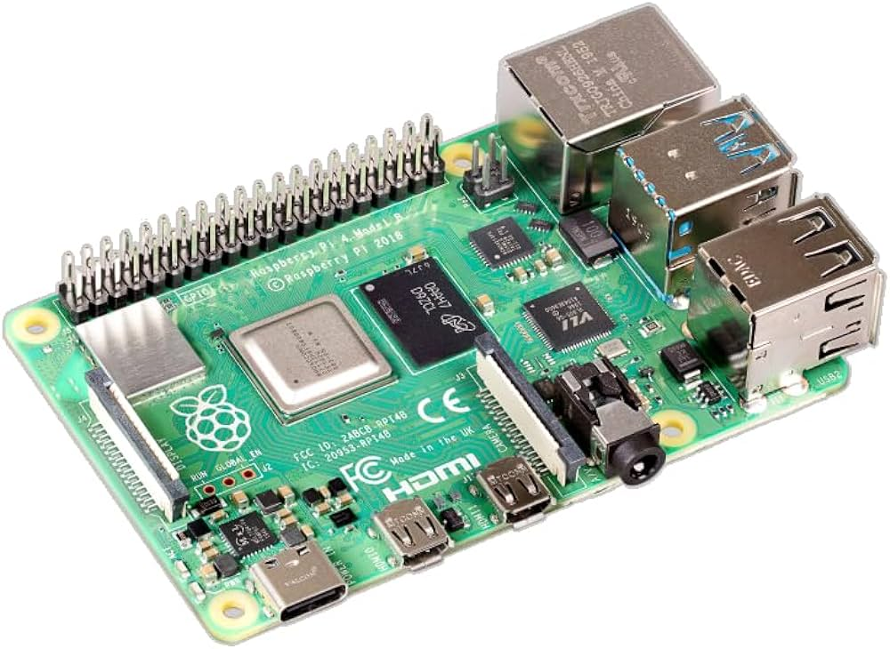
Microcontroller Boards

Slide 4
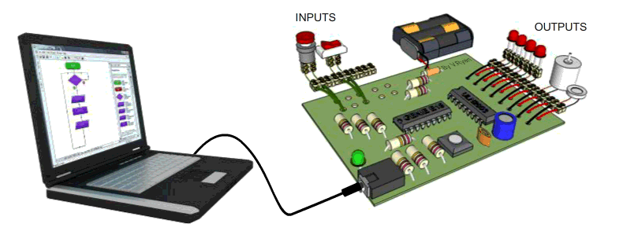
Microcontroller Basis
A program is loaded onto the microcontroller
Typically, only a single program runs on the microcontroller
The program can be designed to perform one single action, such as blinking an LED, or execute hundreds of actions in a cycle
It will start execution as soon as the board is powered

Slide 5
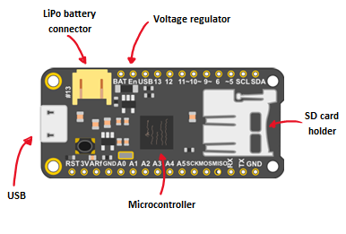
Adalogger Feather M0 Microcontroller
2 ways to power:
USB port - 3.3V supply from the PC (also used to upload code onto the board)
Lithium battery connector – enables the Adalogger to be used when it’s not plugged into a PC
SD card holder – used to read and write measurements to an SD card
Microcontroller - this is the brain! It is the component that we load programs into. Think of it as a tiny computer, designed to execute specific things
Voltage regulator - converts the USB or battery voltage to 3.3V for the microcontroller

Slide 6
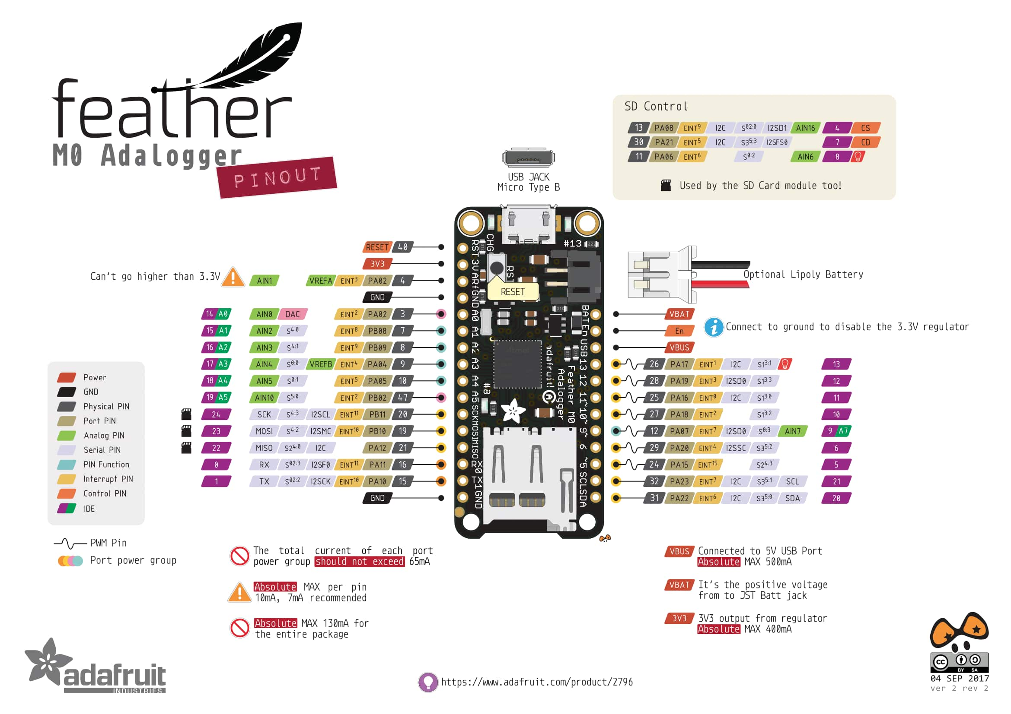
Adalogger Feather M0 Microcontroller
Digital pins - pins that use digital logic (0,1 or LOW/HIGH). Commonly used for switches, turning LED on/off.
Analog pins - pins that can read analog values in a 10-bit resolution (0-1023).
3V pins - these pins are used to power external components – outputs 3.3V from the regulator
GND - common ground for all power and logic

Slide 7
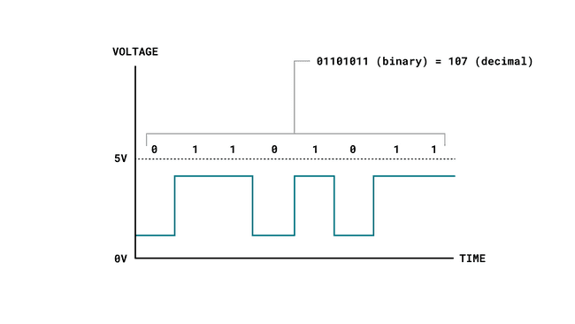
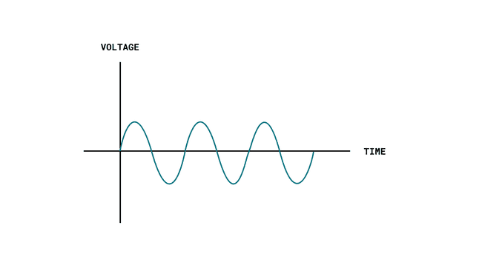
Electrical signals
Microcontrollers can be used to send or receive information to and from electronic components
All communication between electronic components are facilitated by electronic signals
There are two main types of electronic signals: analog & digital
Digital
Analog

Slide 8
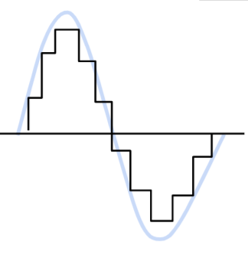
Digital vs Analog
Digital
Analog
A digital signal represents only two binary states (0 or 1) that are read as high or low states in the program.
You can easily read and write digital signals such as a button state, or to turn something on or off.
Sending high or low state rapidly creates a binary sequence or a bitstream.
An analog signal is generally bound to a voltage range. This is typically 0-5V, or 0-3.3V (for the Adalogger).
The microcontroller has a circuit inside called an analog-to-digital converter or ADC
This reads the changing voltage and converts it to a number between 0 and 1023 (for a 10-bit ADC)

Slide 9
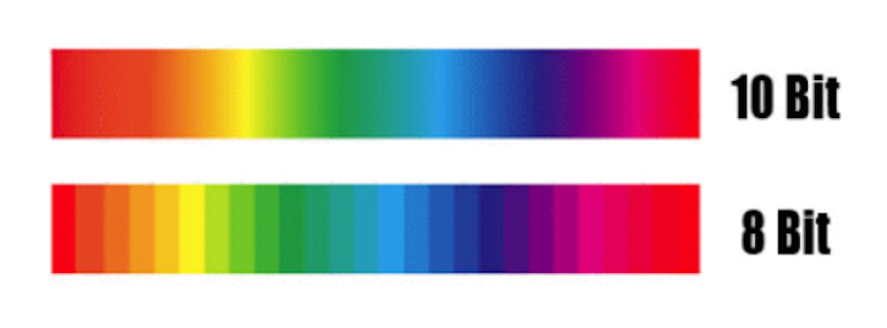
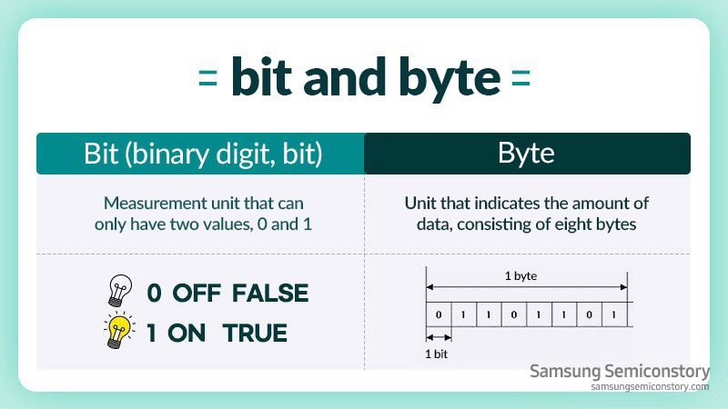
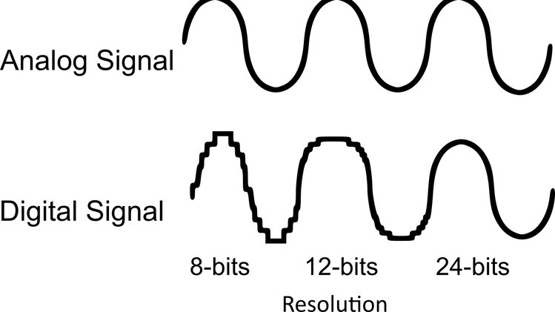
Bits and Bytes

Slide 10
Communication
Digital sensors rely on Serial Communication Protocols to send data
The most common serial communication protocols are UART, SPI & I²C.
The UART protocol is used to send data between a computer and microcontroller boards, such as uploading a new program, or reading data directly from a board.
The SPI and I²C protocols are used for communication between both internal and external components.
I²C protocol allows several sensors to be connected on the same pin, and retrieve the data accurately. Each device has an address that we need to specify in the program, which we use when making data requests.

Slide 11
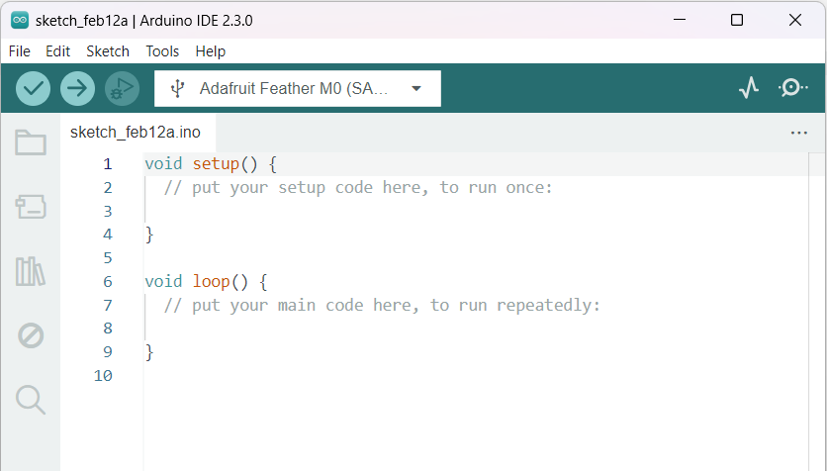
Arduino Programming Language
Based off C/C++ language
In the Arduino project, a program is referred to as a "sketch"
A sketch is a file that you write your program inside
It has the .ino extension, and is always stored in a folder of the same name

Slide 12
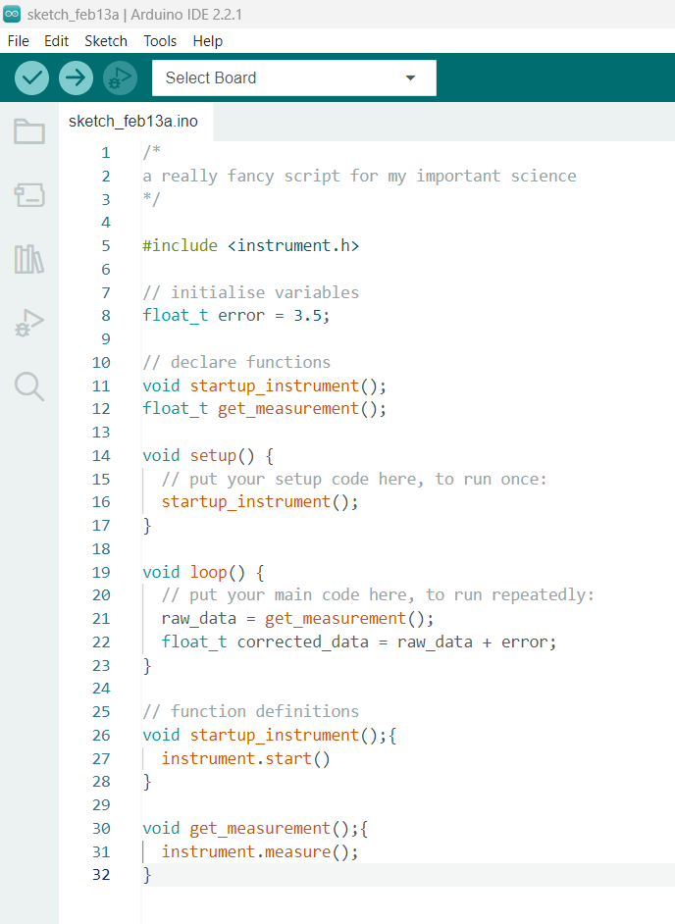


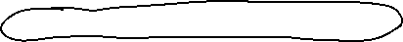



Slide 13
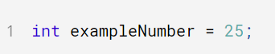
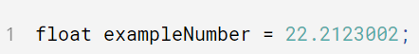
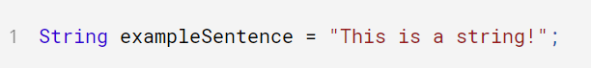
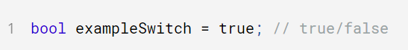
Data Types
Most common types:
int: stores numerical data as an integer
float: stores numerical data with decimals
char: stores a single character value
string: stores text
bool: stores simple states such as true and false

Slide 14
Program Structure
The absolute minimum requirement of an Arduino program is the use of two functions: void setup() and void loop().
The "void" indicates that nothing is returned on execution.
void setup() - this function executes only once, when the Arduino is powered on. Here we define things such as the mode of a pin (input or output), the baud rate of serial communication or the initialization of a library
void loop() - this is where we write the code that we want to execute over and over again, such as turning on/off a lamp based on an input, or to conduct a sensor reading every X seconds.
The above functions are always required in an Arduino sketch, but you are of course able to add several more functions, which is useful for longer programs.

Slide 15
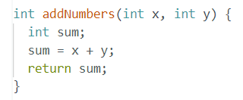
Functions
Functions allow a programmer to divide a specific code into various sections, and each section performs a particular task.
Usually, a function is used to perform a task multiple times in a program.
Parameters passed to the function
Advantages of using a function include:
Increases the readability of the code
Reduces the chances of errors
Makes the program compact and small
Avoids repetition of the same set of statements or commands
Return type
Number of function
Return statement, datatype matches declaration

Slide 16
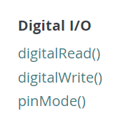
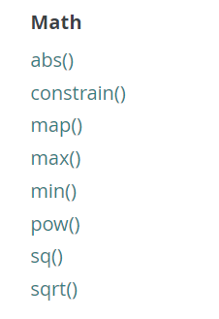
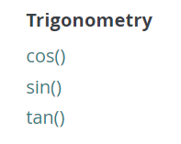
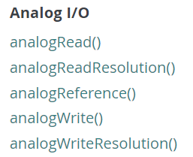
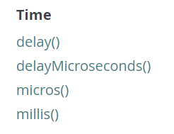
Arduino Functions
Arduino Language Reference

Slide 17
Read and Write
Description
Writes a HIGH or LOW value to a digital pin
If a pin is an OUTPUT, it will send 3.3V for HIGH and 0V for low
Syntax
digitalWrite(pin, value)
Parameters
pin: board pin number
Value: HIGH or LOW
Returns
Nothing
Description
Reads the value from the specified analog pin
The onboard 10-bit ADC will map input voltages between 0-1023
Syntax
analogRead(pin)
Parameters
pin: name of analog input pin
Returns
Number depending on ADC (0-1023)
Description
Reads the value from a specified digital pin, either HIGH or LOW
Syntax
digitalRead(pin)
Parameters
pin: the board pin number you want to read
Returns
HIGH or LOW

Slide 18
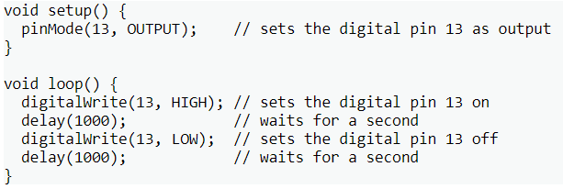
Input vs Outputs
Sensors and actuators, are typically referred to as inputs and outputs
When we write a program, it is common to construct conditionals that checks the state of a sensor, and decide whether it should actuate something.
INPUT pins can be used to read the state of the circuitry attached to them i.e. switches, sensors
OUTPUT pins are used to control external circuitry, i.e. LED’s, speakers, motors
Description
Configures the specified pin to behave either as an input or an output
Syntax
pinMode(pin, mode)
Parameters
pin: the board pin number to set the mode of
mode: INPUT, OUTPUT
Returns
Nothing

Slide 19
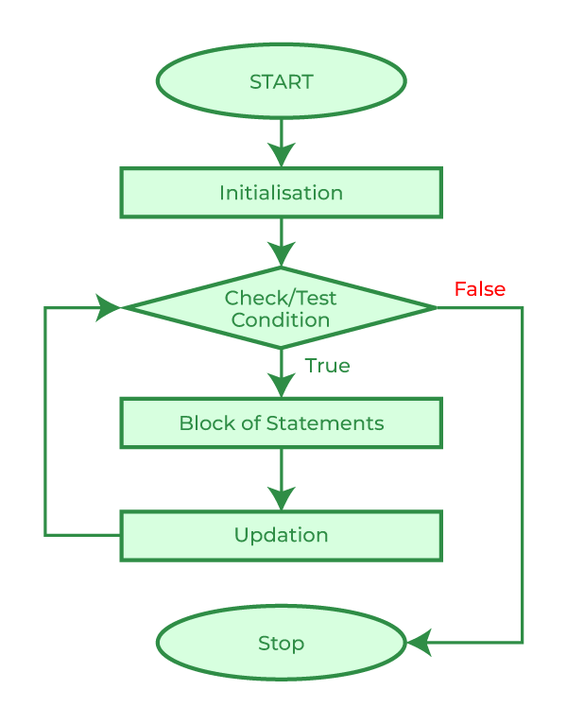
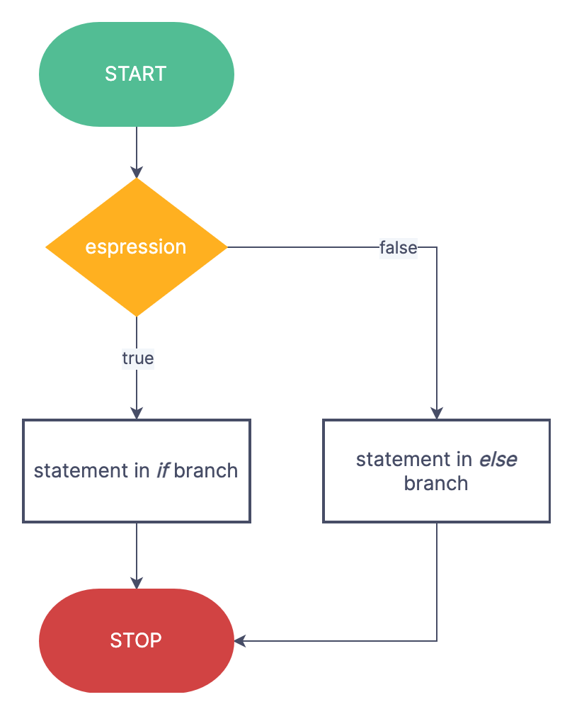
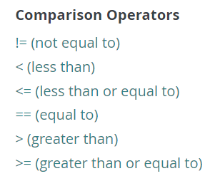
Control Structures
For loops
If Statements

Slide 20
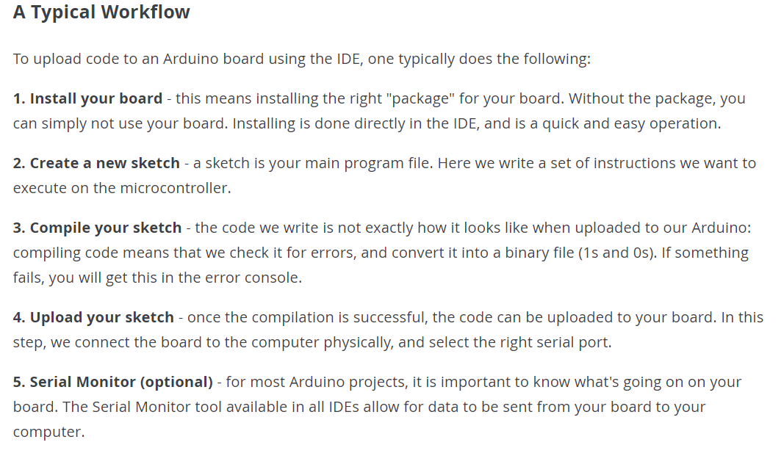
Typical Workflow

Slide 21

Arduino IDE
Board and COM Port Selection
Verify (Compile)
Compile and Upload
Serial Plotter
Serial Monitor
Sketchbook
Boards Manager
Library Manager
Sketch

Slide 22
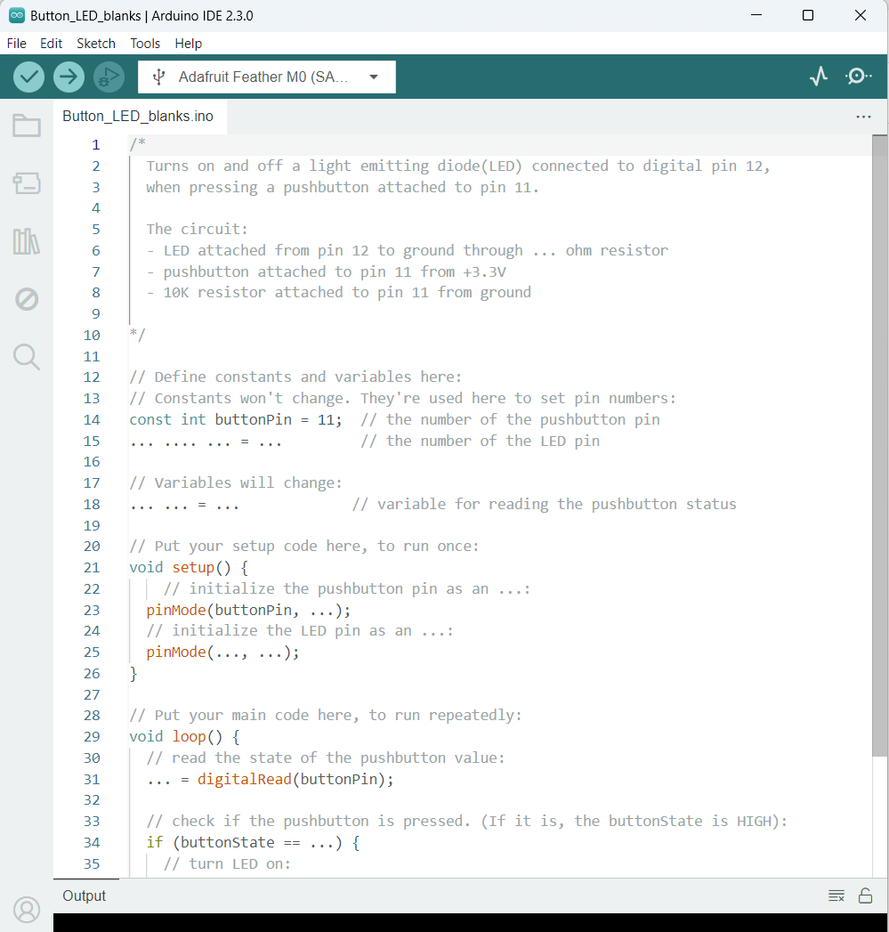
Arduino Example

Slide 23
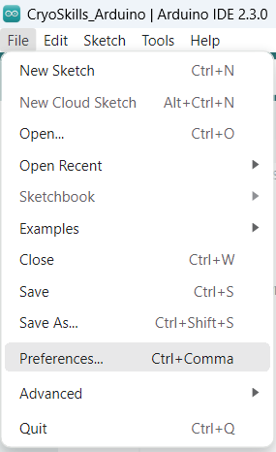
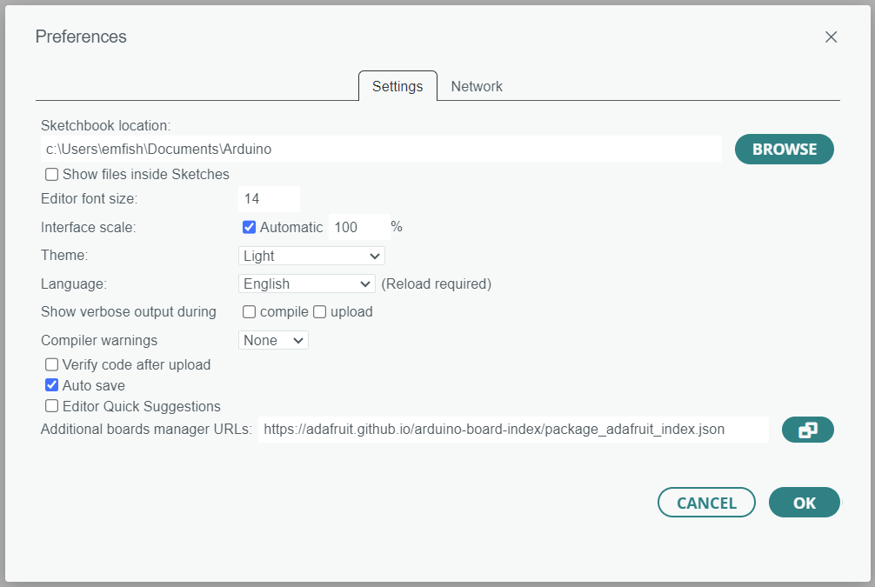
Arduino IDE Setup
Add the Adafruit board to the Arduino IDE:
1. Open Arduino IDE
3. Add the following URL to the Additional boards manager URLs: https://adafruit.github.io/arduino-board-index/package_adafruit_index.json
2. Navigate to Preferences
4. Click OK

Slide 24
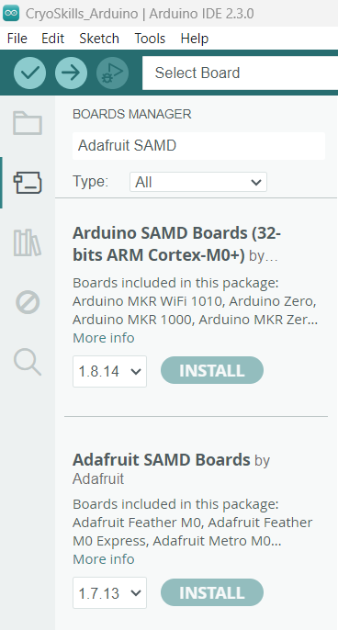
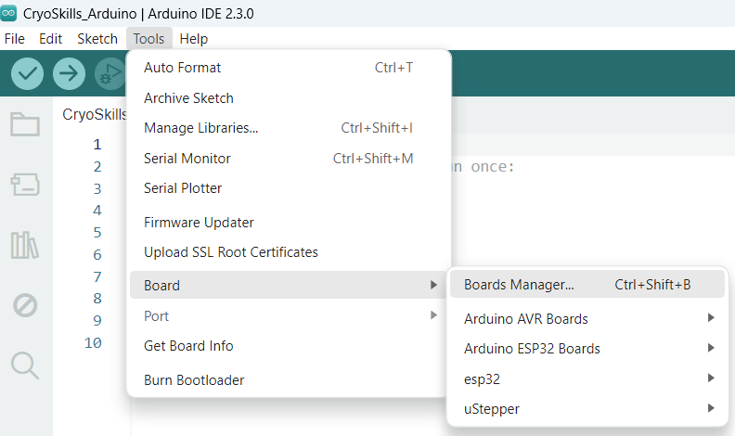
Arduino IDE Setup
2. In the search bar, find the following:
Arduino SAMD
Adafruit SAMD
Install the board support package:
1. Tools -> Boards -> Boards Manager…
3. Click Install on both

Slide 25
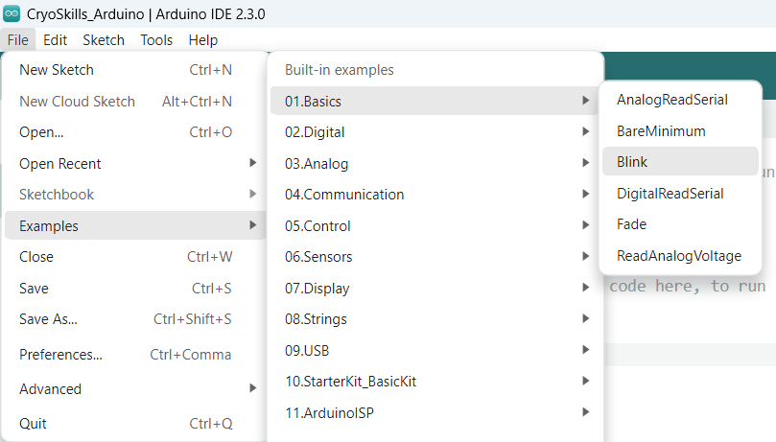
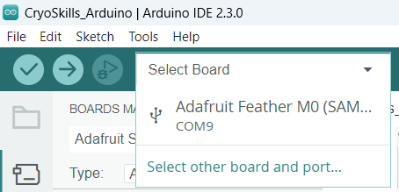
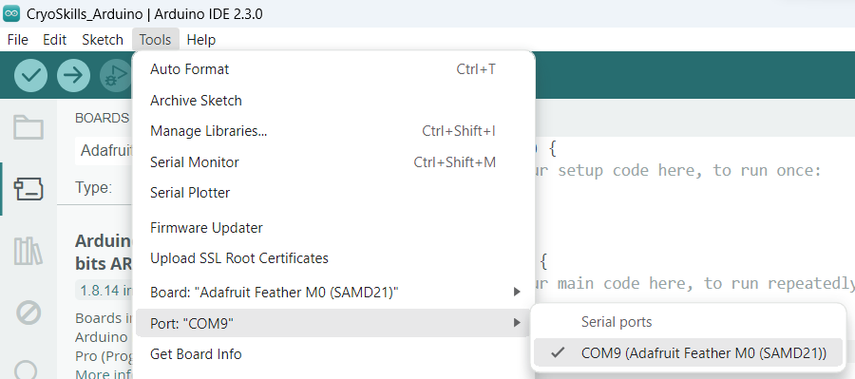
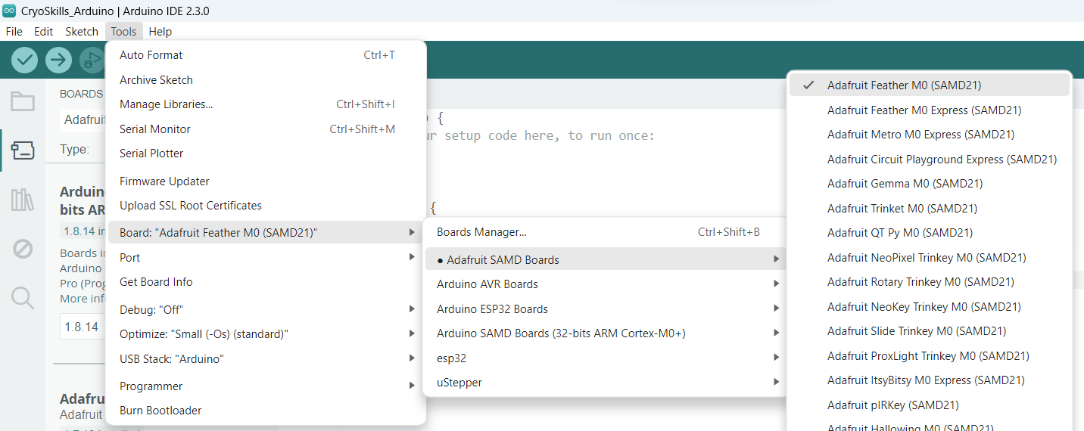
Arduino IDE Setup
Compile and upload your first sketch:
1. Connect your Adalogger to PC using the USB port
2. Select the Adafruit Feather M0 board
3. Upload code: Examples -> Basics -> Blink
OR, you may need to manually select the board and COM port
4. Press the Upload button in the Arduino IDE

Slide 26
Task 1
IDE setup – configure to support the Adalogger board and install the board packages
Compile and upload the Blink sketch
Become familiar with the Arduino IDE environment and programming language
Modify the sketch so the LED stays on for 5 seconds, and turns off for 2 seconds
Look at other examples

Slide 27
Configuring Hardware
Next we are going create a simple circuit by connecting the Adalogger to electrical components…

Slide 28
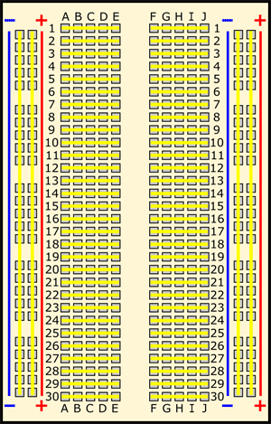
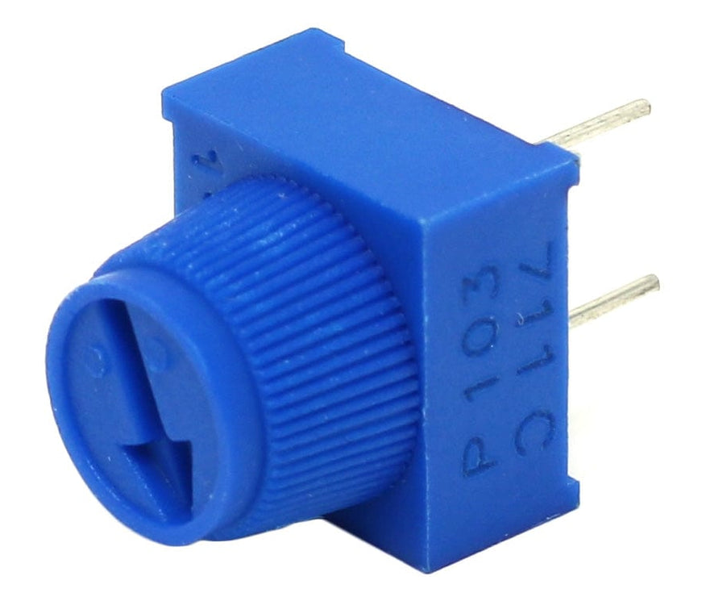
Electrical Components
Breadboard
Potentiometer
Used for prototyping new circuits
Electrical connections shown by yellow lines
A potentiometer is a simple mechanical device that provides a varying amount of resistance when its shaft is turned.
By passing voltage through a potentiometer and into an analog input on your board, it is possible to measure the amount of resistance produced by a potentiometer

Slide 29
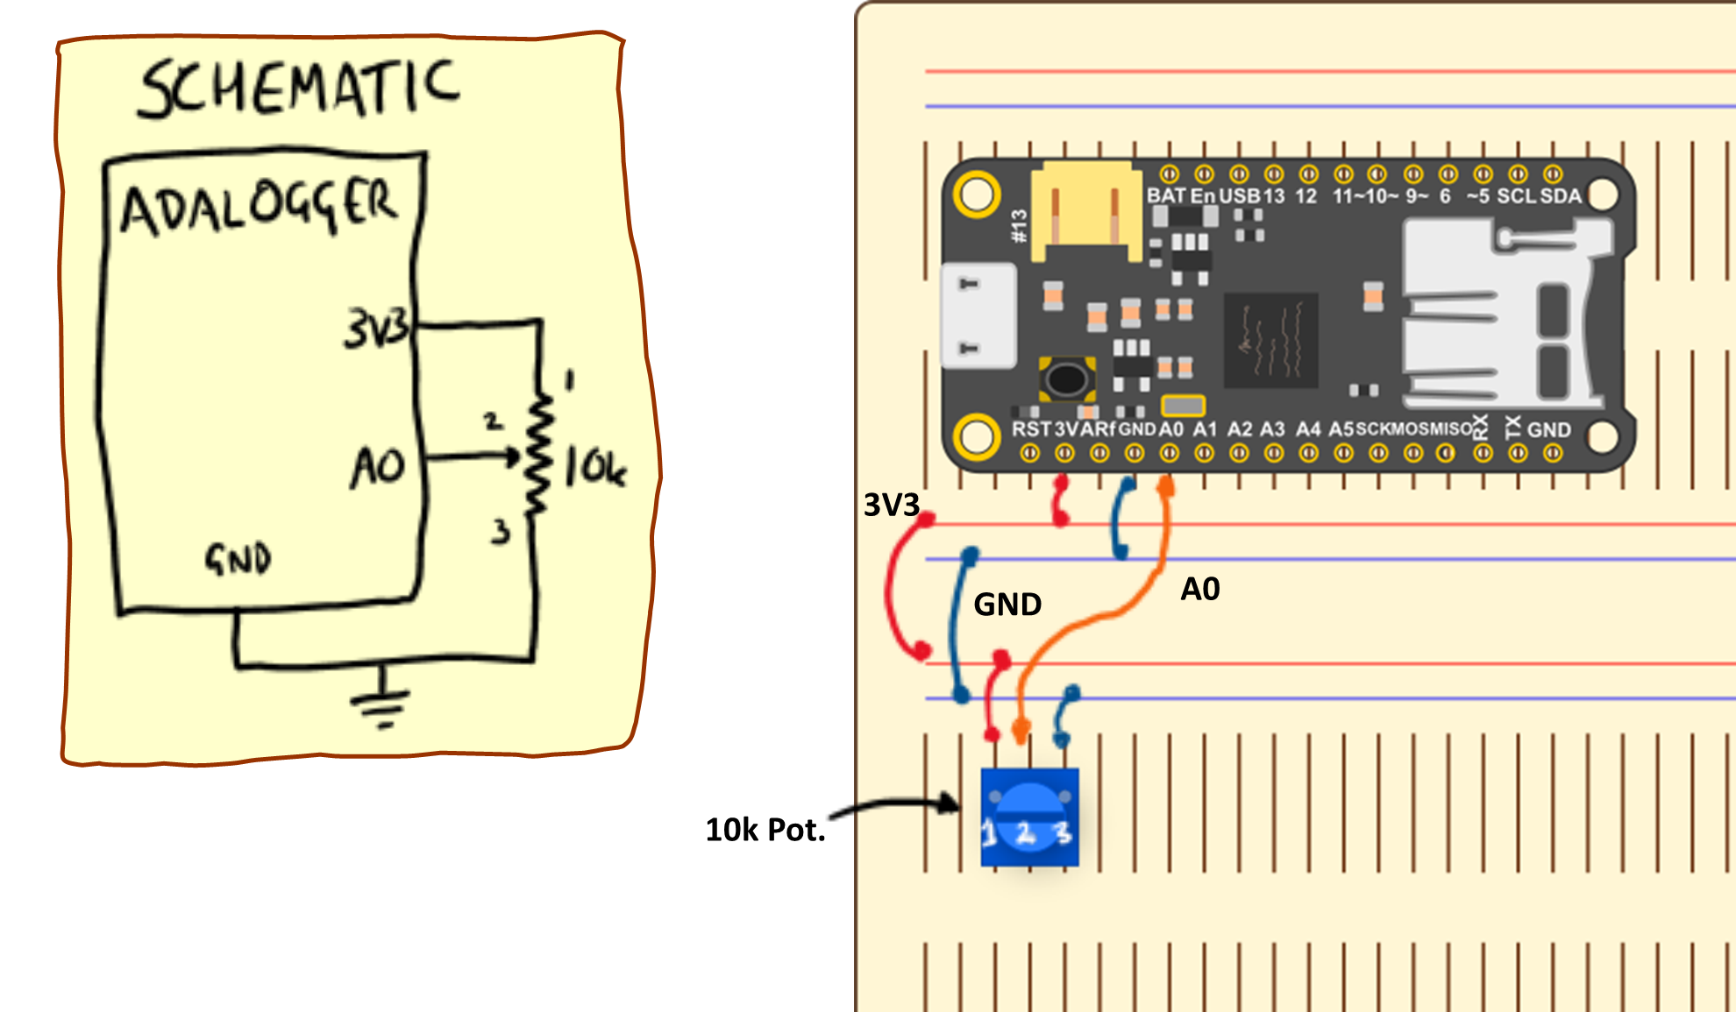
Potentiometer
Wiring Instructions
Place the potentiometer in the breadboard such that the 3 legs are not electrically connected
Make the following connections:
V_{cc} (1) pin to 3V3 rail
Signal (2) pin to A0
GND (3) pin to the GND rail

Slide 30
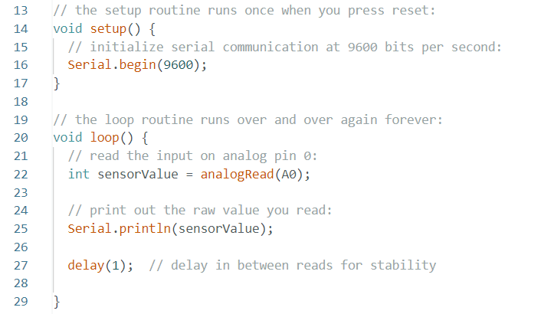

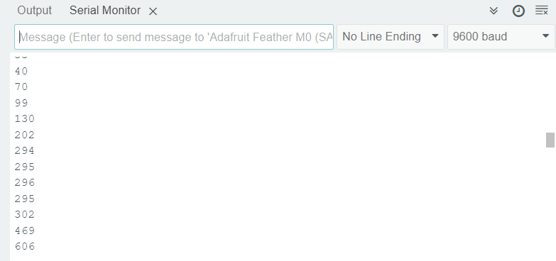
Code and Serial Monitor

Slide 31
Task 2
Connect the potentiometer to the Adalogger via the breadboard
Upload the code to read the analogue value from the potentiometer
Look at the Serial Monitor and Serial Plotter
Modify the code to convert the raw value into a meaningful voltage
Display the voltage in the form… “[number] volts” every 0.1s
Check the voltage you are displaying on screen with a multi-meter
Modify the code to turn the LED on if the voltage is greater than 2.5V
Note: Close the Serial Monitor before uploading a new sketch

Slide 32
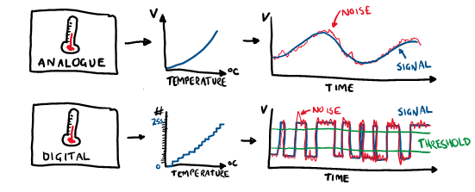
Digital Temperature Sensor
Every temperature sensor has an analogue sensor at its core, but digital temperature sensors take the conversion stage (i.e. measured voltage or current to temperature) out of our hands
Sensors positioned a long distance away from the controller (i.e. over long cables) can be susceptible to noise
In digital signals, the voltage or current are restricted to discrete levels which can be determined by comparison to a threshold value
This makes the signals more resilient to noise but at the cost of discretisation – i.e. the resolution of the measured value is now limited.

Slide 33
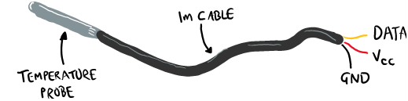
Digital Temperature Sensor
DS18B20 (datasheet)
3-wire sensor V_{cc} (supply voltage), GND (0V) and DATA (signal)
Measurement range = -55°C to 125°C
Error of temperature sensor = ±1°C (between -30°C to 100°C)
Configured to provide 9 or 12-bit resolution
 | 9-bit | 12-bit
Measurement time (ms) | 94 | 750
Minimum temperature difference (°C) | 0.5000 | 0.0625

Slide 34

Digital Temperature Sensor
Wiring Instructions
Connect the GND, V_{cc} and DATA wires to the green 3-way terminal block. Each wire should be in a different terminal
Choose a suitable location on the breadboard and plug in the terminal block
Connect the breadboard trace corresponding to the GND wire to the GND rail, and then do the same for V_{cc} (3V3)
Connect the breadboard trace corresponding to the DATA wire to the same breadboard trace as Pin 5 (D5) on the Adalogger microcontroller
Connect a 4k7 resistor between the V_{cc} and DATA breadboard traces

Slide 35
Arduino Libraries
Arduino libraries are an extension of the standard Arduino programming language
Thousands of free, open-source libraries, both official and contributed by the community
Libraries simplifies the use of otherwise complex code, such as reading a specific sensor, controlling a motor or connecting to the Internet
Simply download and install a library, include it at the top of your code, and use any of the available functionalities of it.

Slide 36


Adding Libraries
1. Download the .ZIP folder which includes:
DS18B20
OneWire
2. Move file location to Arduino libraries directory
(Alternative: In Arduino IDE, Sketch -> Include Library -> Add .ZIP Library -> Locate folder)
3. Include the header file (.h) in your sketch (The header file has definitions for the library):
Sketch -> Include Library -> DS18B20 and OneWire

Slide 37
Task 3
Configure the temperature sensor hardware and connect to the Adalogger
Add the DS18B20 and OneWire library’s to the IDE
Upload the code and display the temperature measurements
Edit the code to print every 5 seconds
Use the function ‘millis()’ to print the time since the program started after each temperature measurement
Convert the temperature loop into a function

Slide 38

Saving to SD card

Slide 39
Task 4
Add the SD and SPI libraries
Use the example SD codes to test reading and writing to the card
Modify the code to save temperature measurements every second
Extension Tasks
Save temperature measurement to the SD card for 10 seconds (1Hz frequency) every minute
Whilst saving temperature measurements, make the LED turn on
Set the led to flash if the temperature is higher than 22°C

